Slide 1
Operating Systems-Fundamentals
Session 1,2,3
Monit Kapoor
SoCSE

Slide 2
Basic Elements of Computing System
????????
Very Commonly known!!!
Like – Processor, Main Memory ,External Memory ,External Devices ,Terminals, Monitors and so on…………..
But From perspective of an OS course???
(WHAT ARE THE ELEMENTS OF A COMPUTING SYSTEM!!!!!)

Slide 3
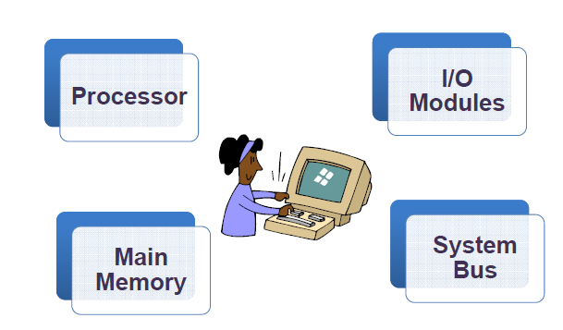
The Basic Elements to a Computing System

Slide 4
Computer Functions
????
Refer to Structure and Functions slide in AdditionalStuff folder

Slide 5
Processor??? Now what’s that
Controller??if yes then what does it controls?
Data Processor???
CPU??
Its all of the three above!!!

Slide 6
Main Memory
Whose Contents are lost when taken off from power
Referred to as Main Memory
Generically , it’s the Volatile memory
Characterized by a faster access time
Cost ??is it an issue still??
But yes Can’t have a Unlimited or very large Main memory!!!!
On demand Availability!!!!! A possibility now

Slide 7
I/O Modules
Responsible for Moving data between Computer and External Environments
External Environments???Any Idea?
Broadly Speaking these would be:
Storage, Communication Equipment, Terminals

Slide 8
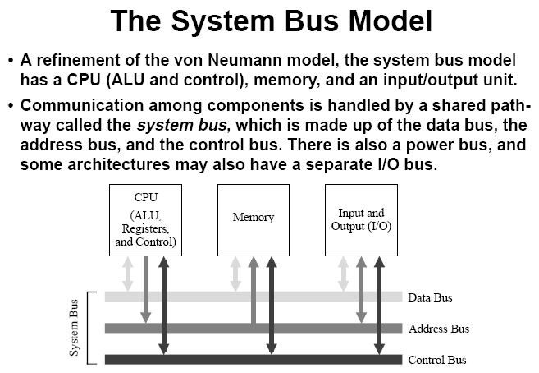
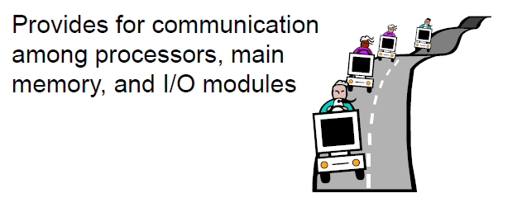
System Bus

Slide 9
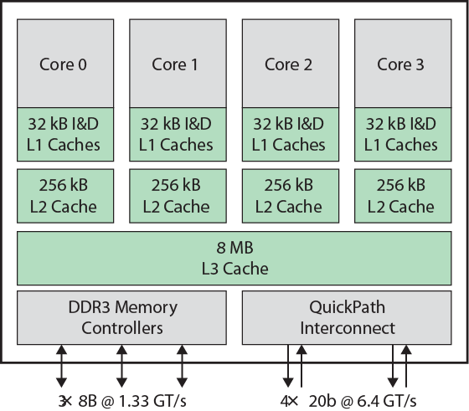
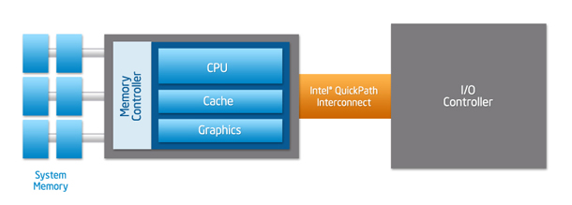
Multicore Computers-Intel Core i7

Slide 10
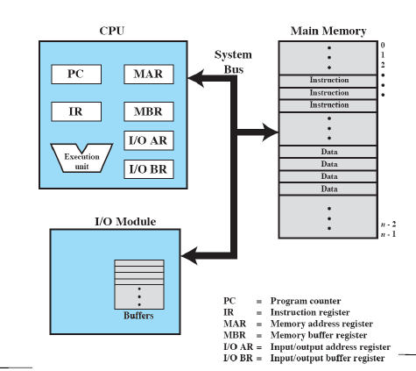
Computer Components-Top Level View _{(See Slide Notes *)}
Notes:
(i) An I/O module is a mediator between the processor and an I/O device/devices.
(ii) It controls the data exchange between the external devices and main memory; or external devices and CPU registers.
(iii) An I/O module provide an interface internal to the computer which connects it to CPU and main memory and an interface external to the computer connecting it to external device or peripheral.
(iv) The I/O module should not only communicate the information from CPU to I/O device, but it should also coordinate these two.
(v) In addition since there are speed differences between CPU and I/O devices, the I/O module should have facilities like buffer (storage area) and error detection mechanism.

Slide 11
Processor Registers
Control and Status Registers
PC and IR
PSW
User Visible Registers
Data Registers - GPRs
Address Registers
Index Registers , Segment Pointer , Stack Pointer

Slide 12
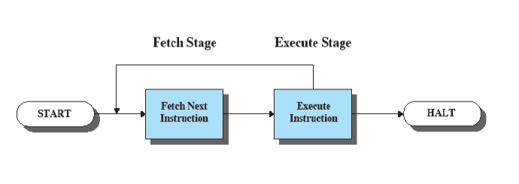
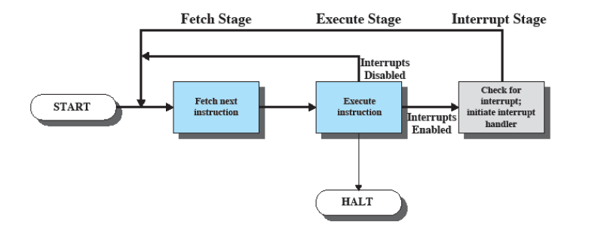
Basic Instruction Cycle and Instruction Cycle With Interupts

Slide 13
Interrupts versus Procedures
Interrupts
• Initiated by both software and hardware
• Can handle anticipated and unanticipated internal as well as external events
• ISRs or interrupt handlers are memory resident
• Use numbers to identify an interrupt service
• (E)FLAGS register is saved automatically
Procedures
• Can only be initiated by software
• Can handle anticipated events that are coded into the program
• Typically loaded along with the program
• Use meaningful names to indicate their function
• Do not save the (E)FLAGS registe

Slide 14
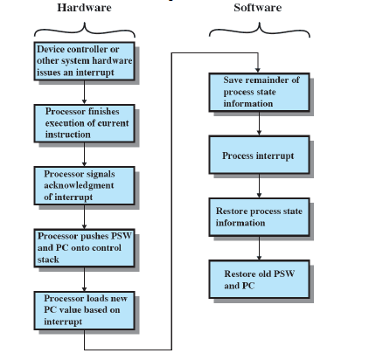
A Simple Interrupt Processing.

Slide 15
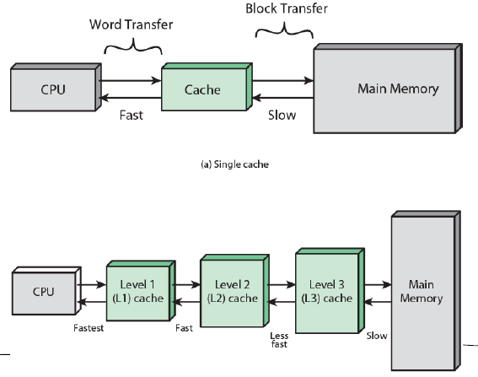
Cache and Main Memory

Slide 16
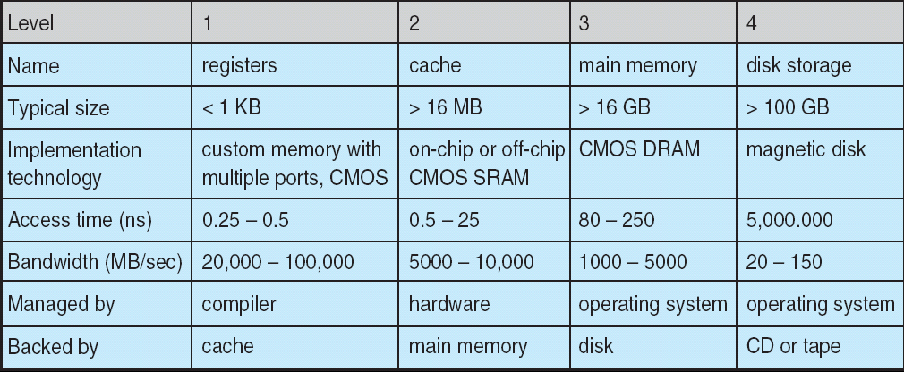
Performance of Various Levels of Storage
Movement between levels of storage hierarchy can be explicit or implicit

Slide 17
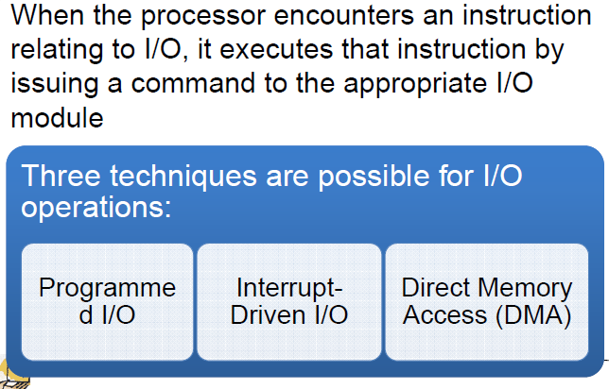
I/O Techniques

Slide 18
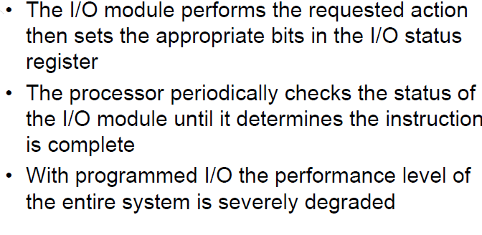
Programmed I/O

Slide 19
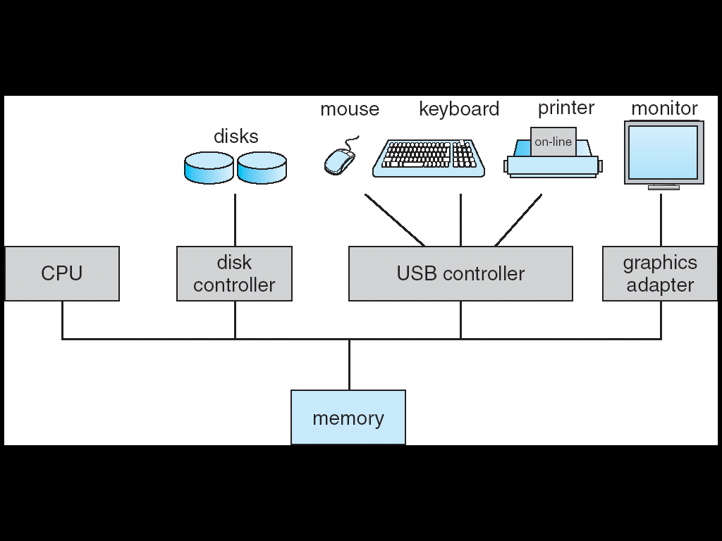
Computer System Organization
Computer-system operation
One or more CPUs, device controllers connect through common bus providing access to shared memory
Concurrent execution of CPUs and devices competing for memory cycles

Slide 20
I/O Structure
A Computer System consists of CPUs and Multiple Device Controllers , connected to a common bus.
SCSI: Small Computer Systems Interface , SCSI Controller.
Device Controller is responsible for moving data between peripherals and local buffer.
O/S will have a device driver for each device controller.

Slide 21
Device Driver and Interrupt driven I/O
Understands the device controller and presents the uniform interface to the device to the rest of operating system.
Steps of Interrupt Driven I/O
The device driver loads the registers within the device controllers.
Device controller in turn examines the contents of these registers.
Device controllers then takes action like reading contents from keyboard.
Controller starts transfer of data from device to local buffer.
After completion, device controller will inform device driver via an interrupt that about finishing execution.
Device driver then returns control to the operating system

Slide 22
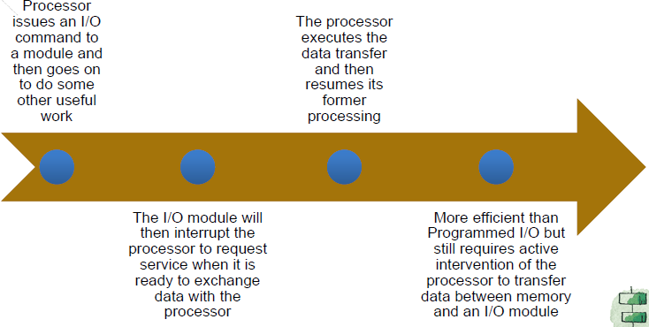
Interrupt Driven I/O
Any Limitations???Can you Spot Some??

Slide 23
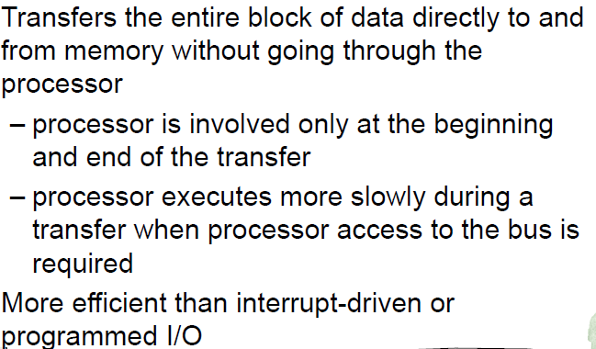
DMA

Slide 24
DMA
Set up buffers,pointers,counters.
Device controller transfers entire block of data to or from its own buffer storage to memory.
CPU need not intervene
One interrupt generated per block, to inform the device driver about completion of information.
CPU free to do other works while this is in progress.

Slide 25
Operating System-Operations
Interrupt driven by hardware
Software error or request creates exception or trap
Division by zero, request for operating system service
Other process problems include infinite loop, processes modifying each other or the operating system
Dual-mode operation allows OS to protect itself and other system components
User mode and kernel mode
Mode bit provided by hardware
Provides ability to distinguish when system is running user code or kernel code
Some instructions designated as privileged, only executable in kernel mode
System call changes mode to kernel, return from call resets it to user

Slide 26
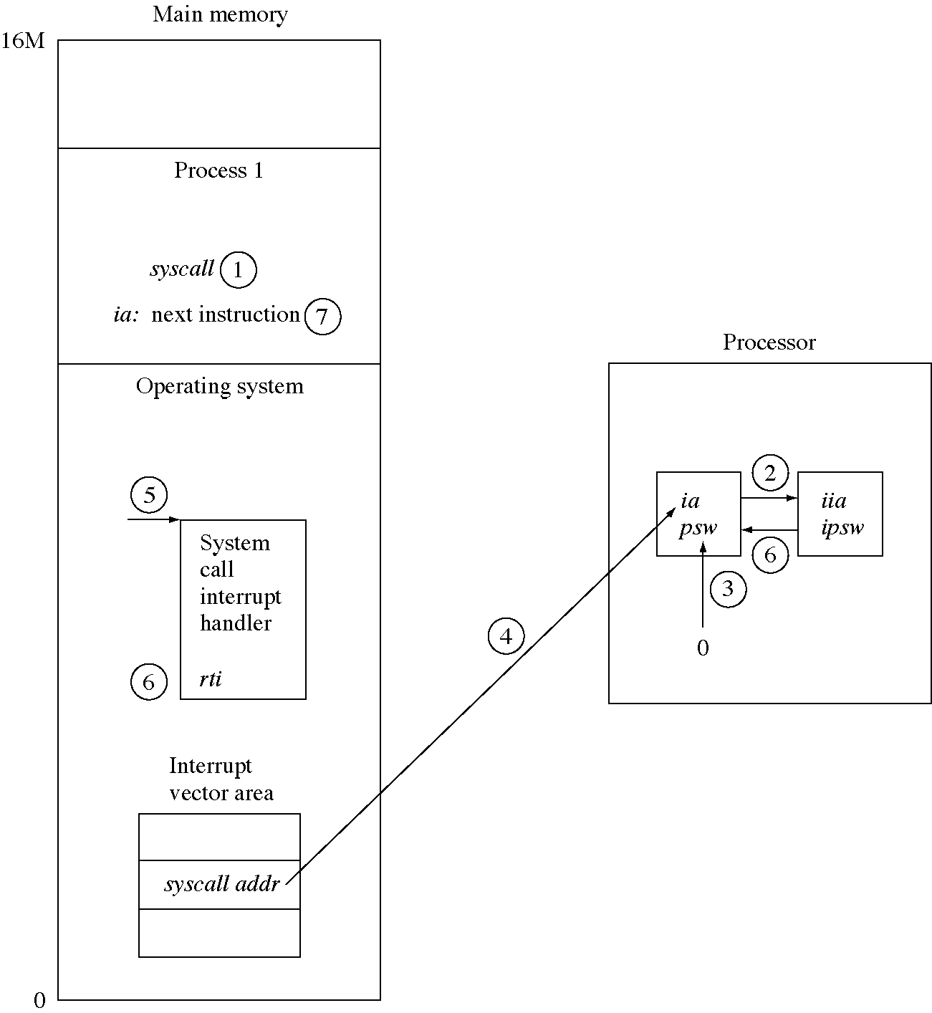
System call flow of control (*See Slide Notes)
Notes:
ia:instruction address register
iia:interupt instruction address register
psw:program status word
ipsw:interupt program status word
A system call instruction is an instruction that does not execute a specific function in hardware but instead generates an interupt that causes the O/S to gain control of processor. The O/S determines what kind of system call it is and performs the appropriate service for the system caller.

Slide 27
Dual Mode Operation

Slide 28
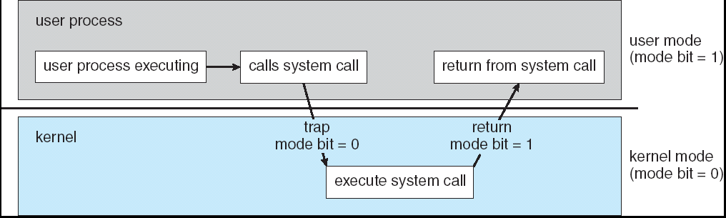
Transition from User to Kernel Mode
Timer to prevent infinite loop / process hogging resources
Set interrupt after specific period
Operating system decrements counter
When counter zero generate an interrupt
Set up before scheduling process to regain control or terminate program that exceeds allotted time

Slide 29
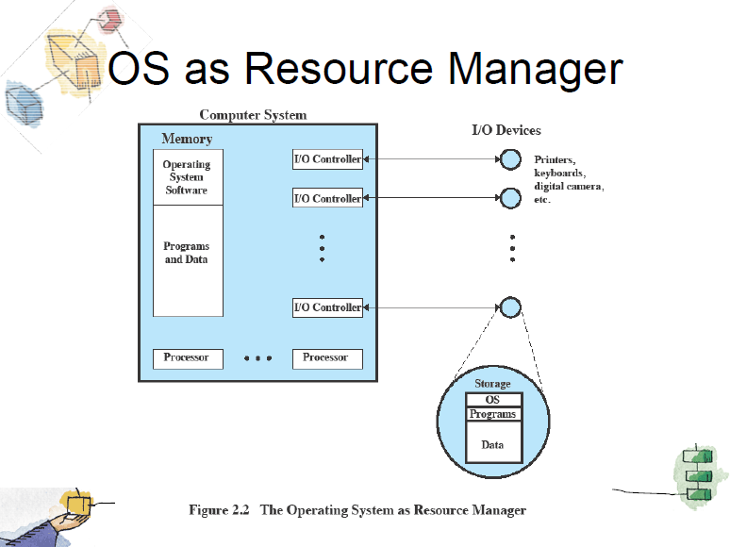

Slide 30
Process Management
A process is a program in execution. It is a unit of work within the system. Program is a passive entity, process is an active entity.
Process needs resources to accomplish its task
CPU, memory, I/O, files
Initialization data
Process termination requires reclaim of any reusable resources
Single-threaded process has one program counter specifying location of next instruction to execute
Process executes instructions sequentially, one at a time, until completion
Multi-threaded process has one program counter per thread
Typically system has many processes, some user, some operating system running concurrently on one or more CPUs
Concurrency by multiplexing the CPUs among the processes / threads

Slide 31
Process Management Activities
The operating system is responsible for the following activities in connection with process management:
Creating and deleting both user and system processes
Suspending and resuming processes
Providing mechanisms for process synchronization
Providing mechanisms for process communication
Providing mechanisms for deadlock handling

Slide 32
Memory Management
All data in memory before and after processing
All instructions in memory in order to execute
Memory management determines what is in memory when
Optimizing CPU utilization and computer response to users
Memory management activities
Keeping track of which parts of memory are currently being used and by whom
Deciding which processes (or parts thereof) and data to move into and out of memory
Allocating and deallocating memory space as needed

Slide 33
Storage Management
OS provides uniform, logical view of information storage
Abstracts physical properties to logical storage unit - file
Each medium is controlled by device (i.e., disk drive, tape drive)
Varying properties include access speed, capacity, data-transfer rate, access method (sequential or random)
File-System management
Files usually organized into directories
Access control on most systems to determine who can access what
OS activities include
Creating and deleting files and directories
Primitives to manipulate files and dirs
Mapping files onto secondary storage
Backup files onto stable (non-volatile) storage media

Slide 34
Mass-Storage Management
Usually disks used to store data that does not fit in main memory or data that must be kept for a “long” period of time.
Proper management is of central importance
Entire speed of computer operation hinges on disk subsystem and its algorithms
OS activities
Free-space management
Storage allocation
Disk scheduling
Some storage need not be fast
Tertiary storage includes optical storage, magnetic tape
Still must be managed
Varies between WORM (write-once, read-many-times) and RW (read-write)

Slide 35
I/O Subsystem
One purpose of OS is to hide peculiarities of hardware devices from the user
I/O subsystem responsible for
Memory management of I/O
including buffering (storing data temporarily while it is being transferred),
caching (storing parts of data in faster storage for performance),
spooling (the overlapping of output of one job with input of other jobs)
General device-driver interface
Drivers for specific hardware devices

Slide 36
Protection and Security
Protection – any mechanism for controlling access of processes or users to resources defined by the OS
Security – defense of the system against internal and external attacks
Huge range, including denial-of-service, worms, viruses, identity theft, theft of service
Systems generally first distinguish among users, to determine who can do what
User identities (user IDs, security IDs) include name and associated number, one per user
User ID then associated with all files, processes of that user to determine access control
Group identifier (group ID) allows set of users to be defined and controls managed, then also associated with each process, file
Privilege escalation allows user to change to effective ID with more rights

Slide 37
Computing Environments
Traditional computer
Blurring over time
Office environment
PCs connected to a network, terminals attached to mainframe or minicomputers providing batch and timesharing
Now portals allowing networked and remote systems access to same resources
Home networks
Used to be single system, then modems
Now firewalled, networked

Slide 38
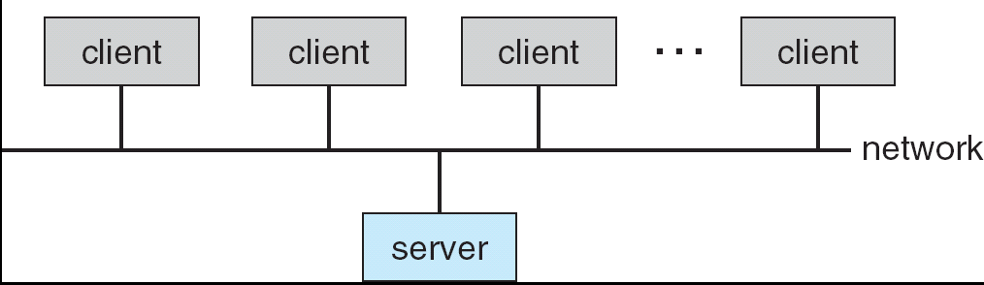
Computing Environments (Cont.)
Client-Server Computing
Dumb terminals supplanted by smart PCs
Many systems now servers, responding to requests generated by clients
Compute-server provides an interface to client to request services (i.e. database)
File-server provides interface for clients to store and retrieve files

Slide 39
Peer-to-Peer Computing
Another model of distributed system
P2P does not distinguish clients and servers
Instead all nodes are considered peers
May each act as client, server or both
Node must join P2P network
Registers its service with central lookup service on network, or
Broadcast request for service and respond to requests for service via discovery protocol
Examples include Napster and Gnutella

Slide 40
Web-Based Computing
Web has become ubiquitous
PCs most prevalent devices
More devices becoming networked to allow web access
New category of devices to manage web traffic among similar servers: load balancers
Use of operating systems like Windows 95, client-side, have evolved into Linux and Windows XP, which can be clients and servers

Slide 41
Credits-where it is due
Operating Systems-Internals and Design Principles-4th Edition by William Stallings
Operating System Concepts-8th Edition by Silberschatz , Galvin and Gagne.
Thanks
Queries @ mkapoor@ddn.upes.ac.in

